Slide 1
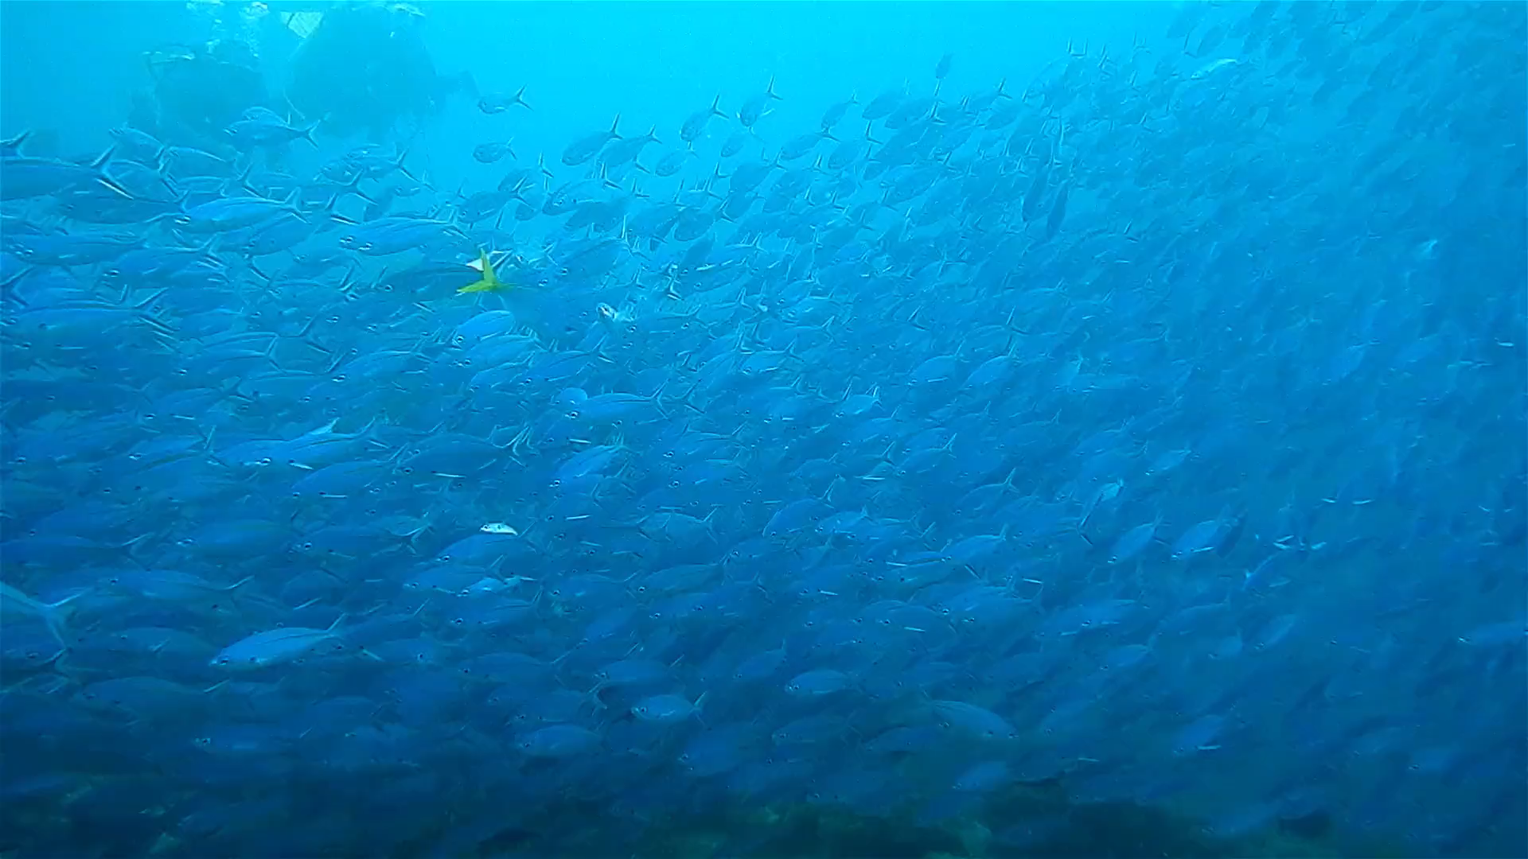






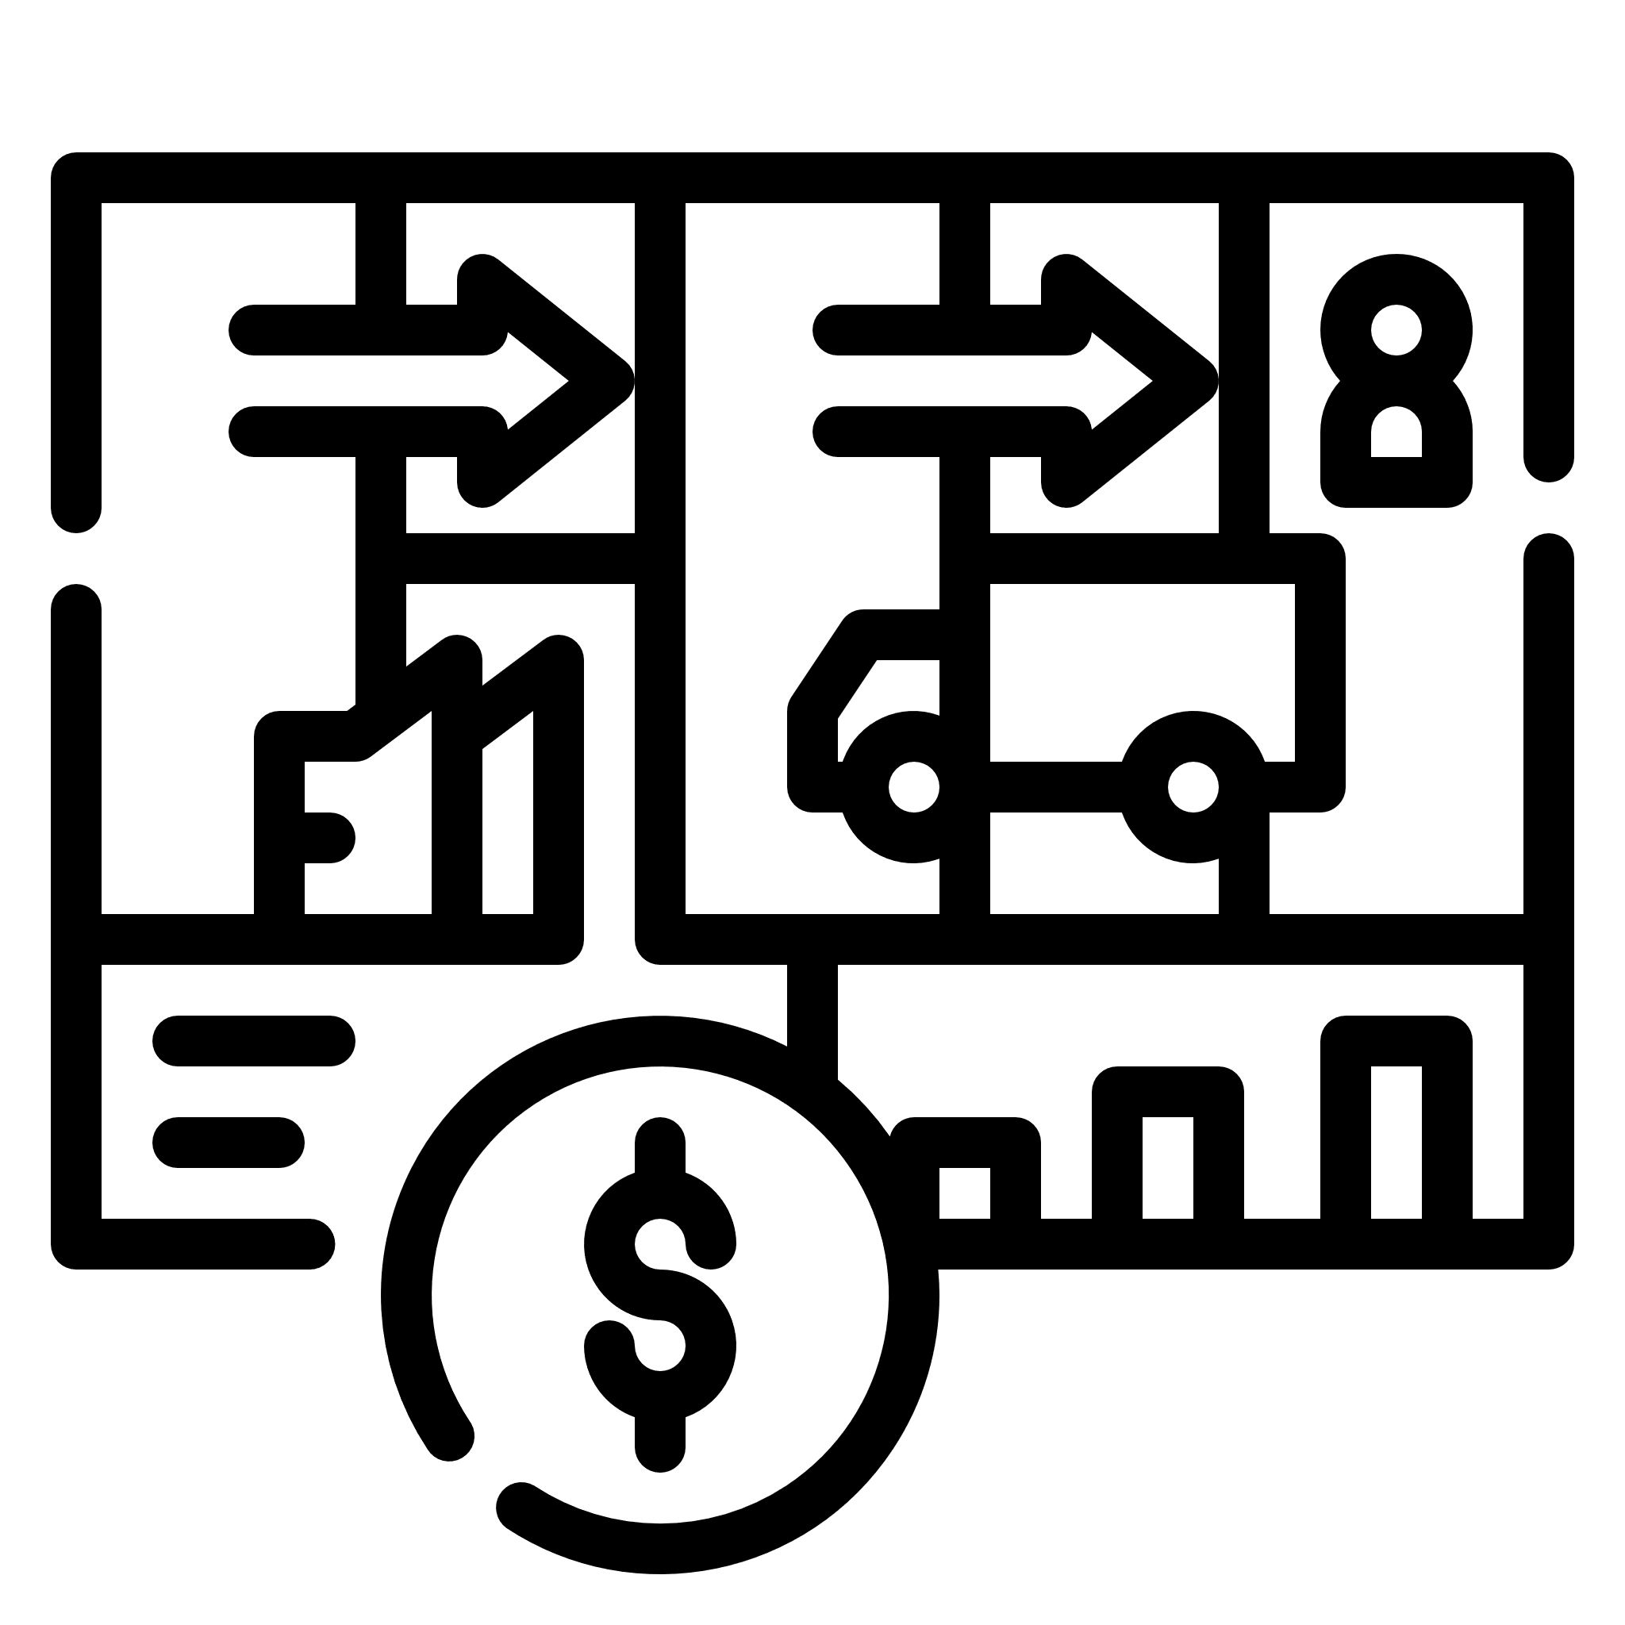



Slide 2


“
I have been in the aquaculture business for the past two years.
Currently, my farm is out of service as a result of poor fish growth and reduced profits.
This is because of two problems: one of irregular and excessive feeding, and the other of inability to accurately determine the water quality of the pond.
Both are due to the unavailability of caretakers with the required technical know-how
- Seyram, UENR

Slide 3
“
I have been in the aquaculture business for the past two years.
Currently, my farm is out of service as a result of poor fish growth and reduced profits.
This is because of two problems: one of irregular and excessive feeding, and the other of inability to accurately determine the water quality of the pond.
Both are due to the unavailability of caretakers with the required technical know-how
- Seyram, UENR

Slide 4




No real-time stress detection

Slide 5
No weather based feeding decision making system

Slide 6
No online community assistance

Slide 7


AI & IoT-powered package
A holistic approach to increasing aquaculture yield
Tailor-made and automated solutions for a target audience

Slide 8

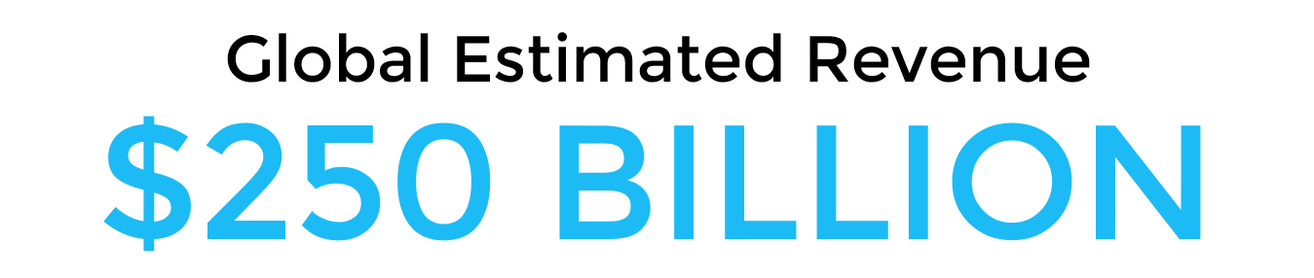


Slide 9
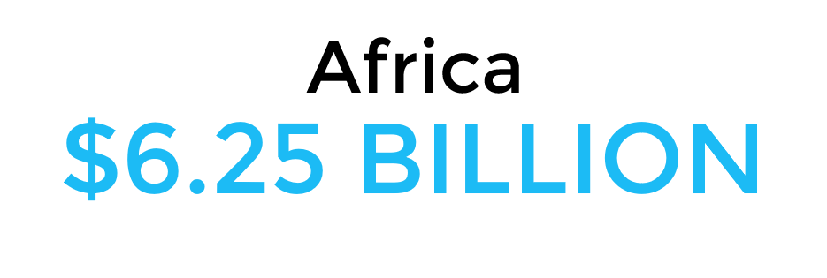

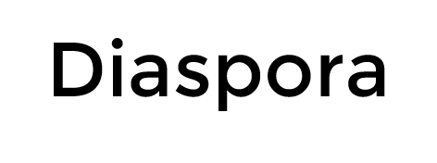

Slide 10
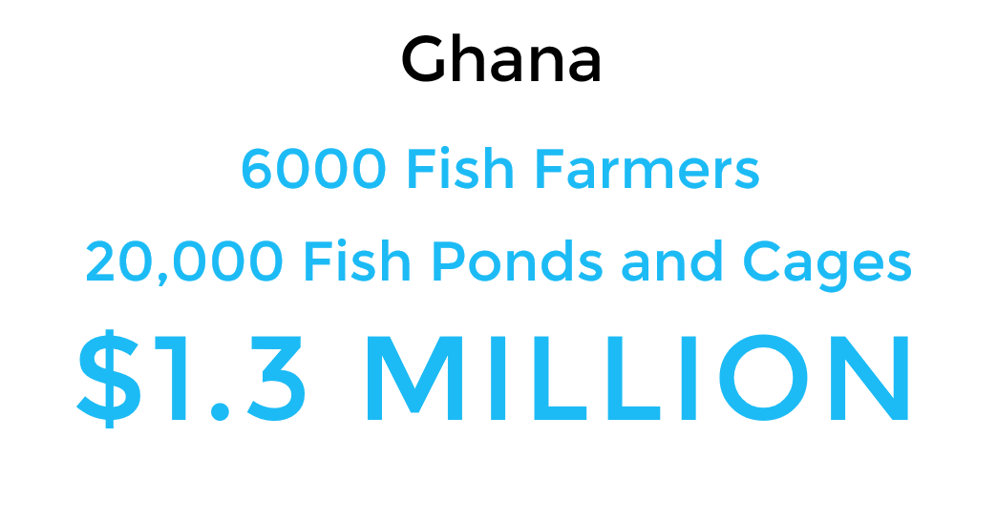
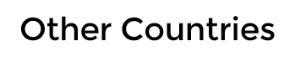

Slide 11

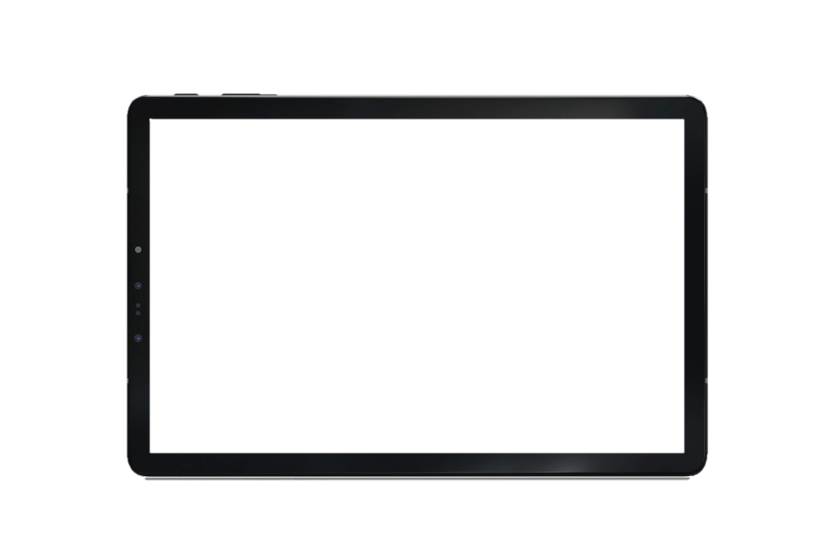


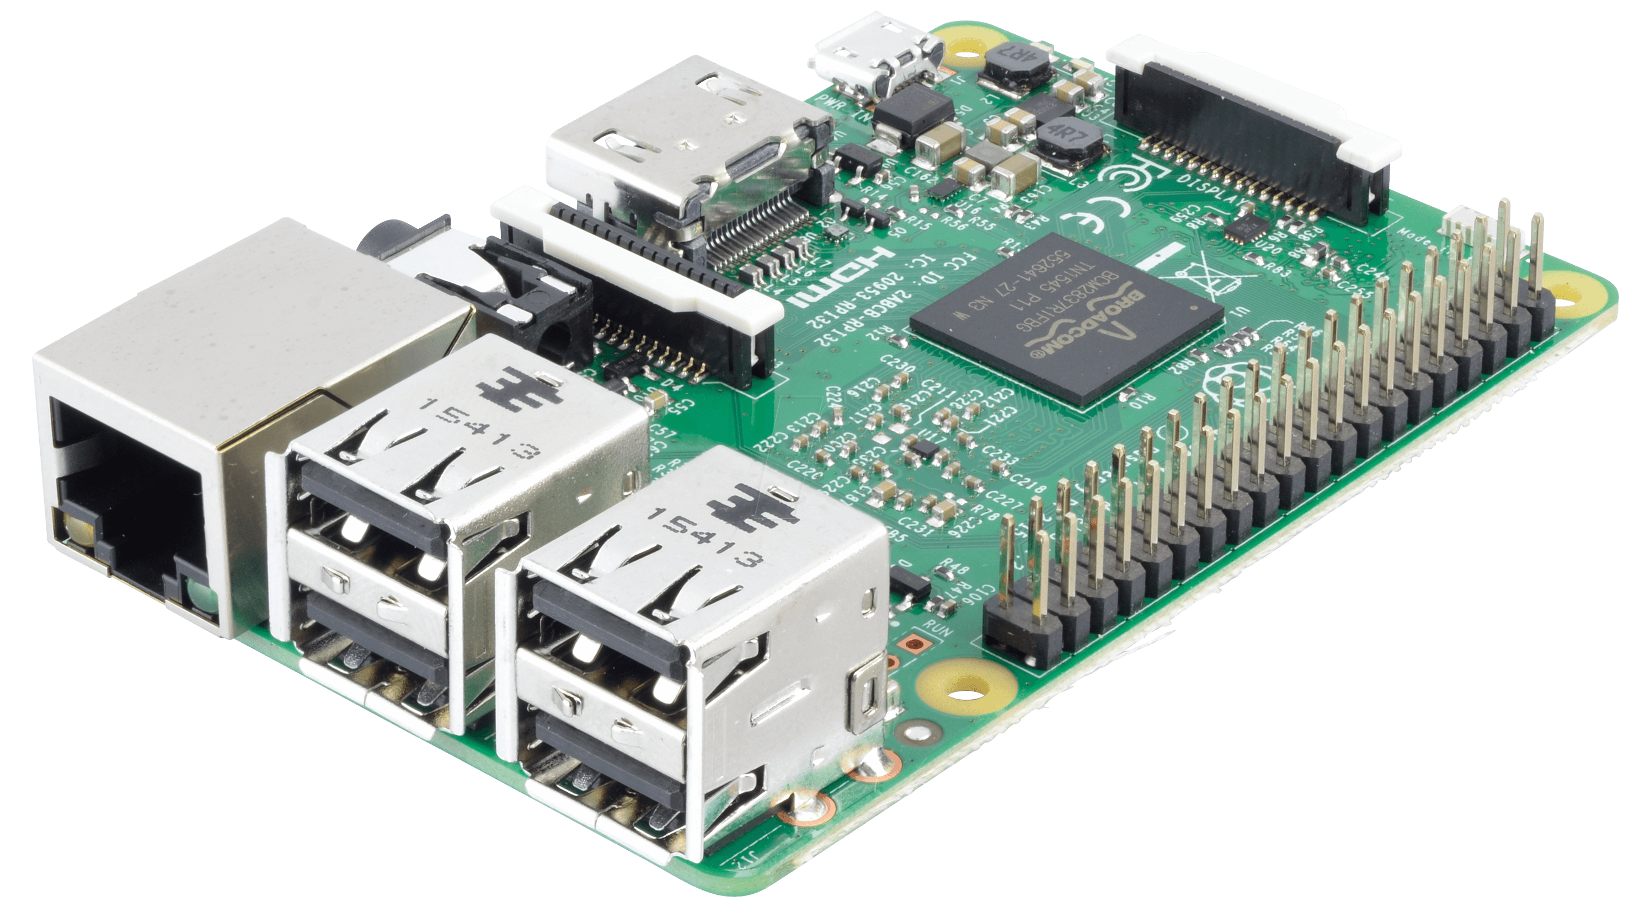
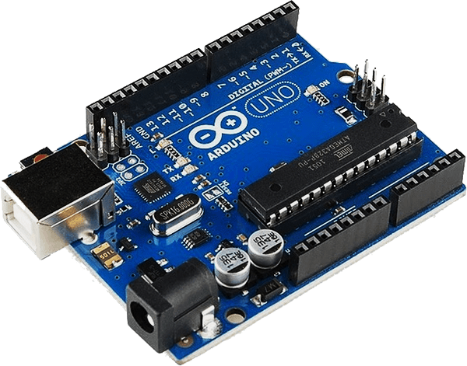


Slide 12
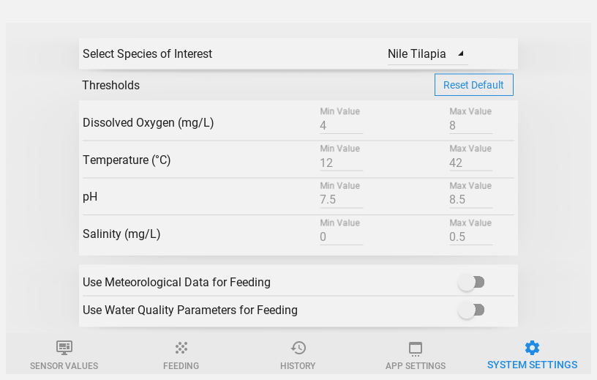
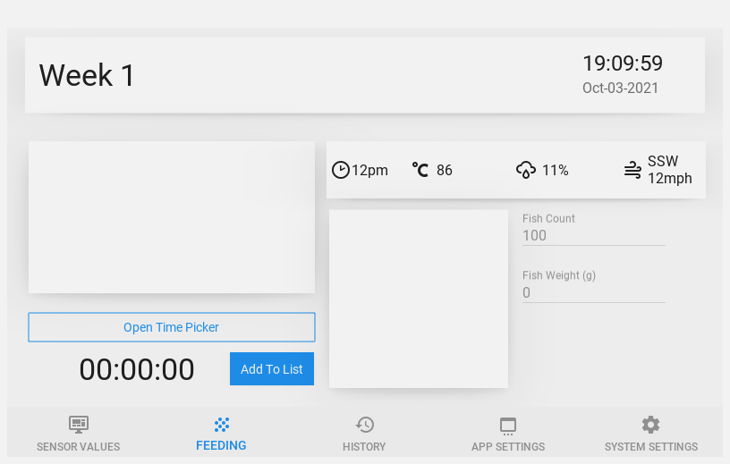
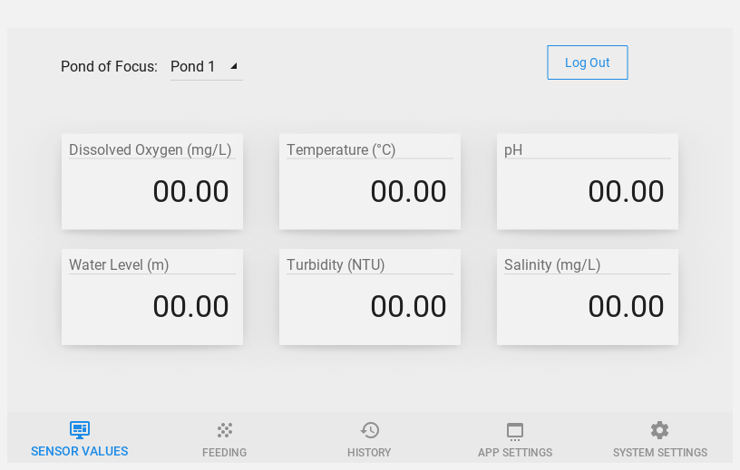
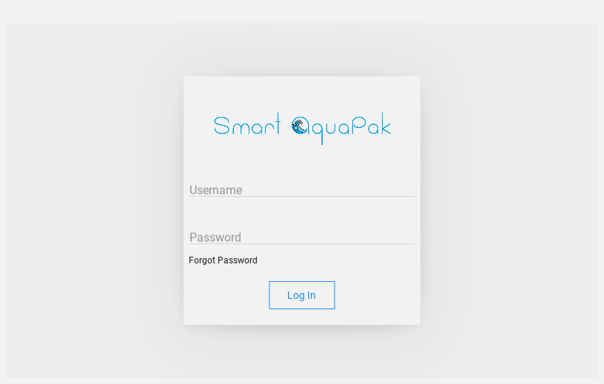

Slide 15
Fish Detection
Length Estimation
Weight Prediction

Slide 16
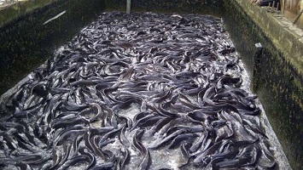
Challenge: Overcrowding

Slide 17


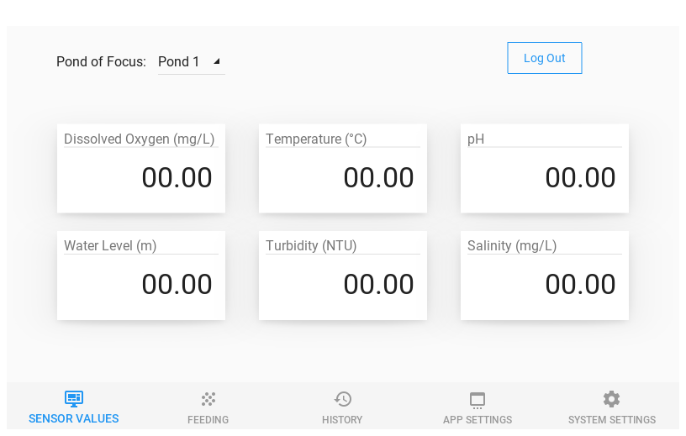
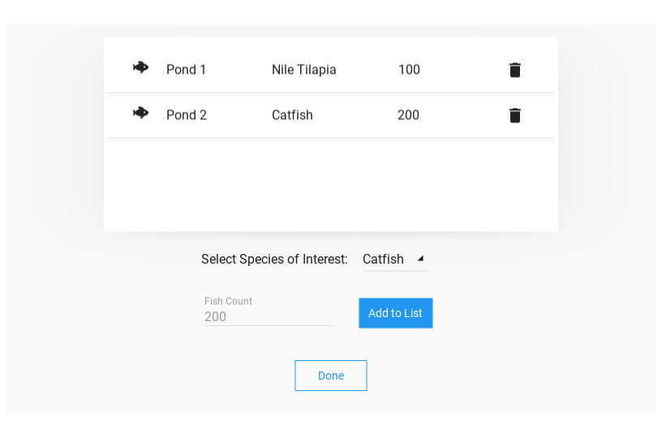
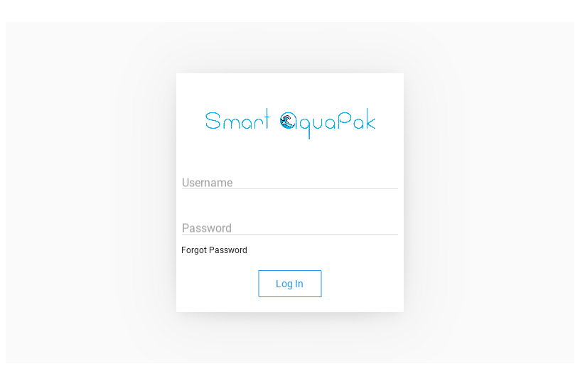
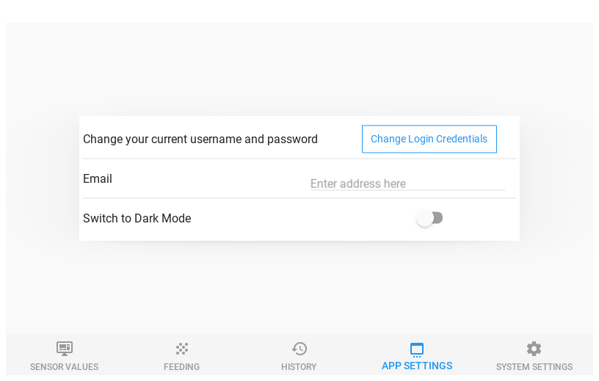

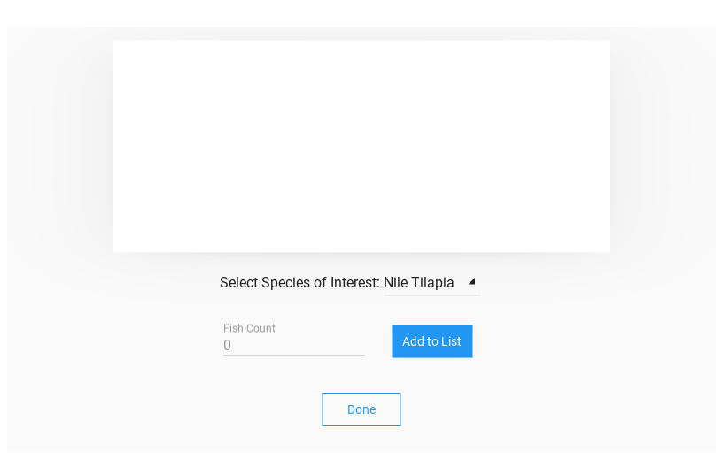
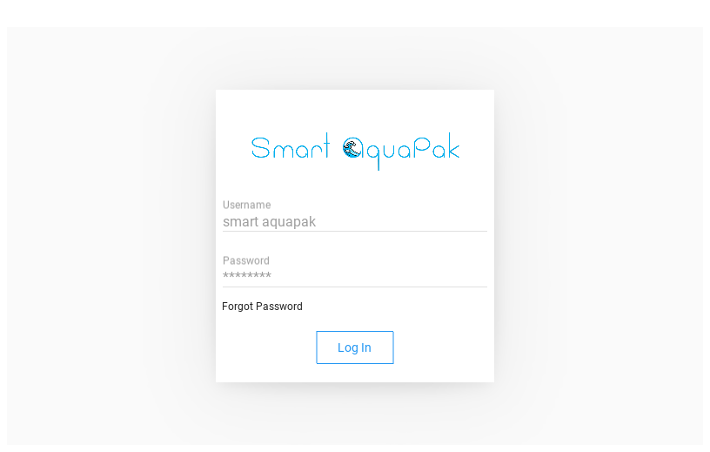


Slide 19
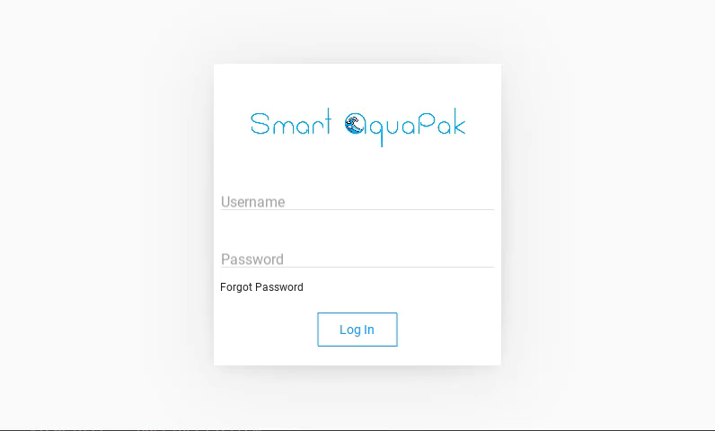

Slide 20
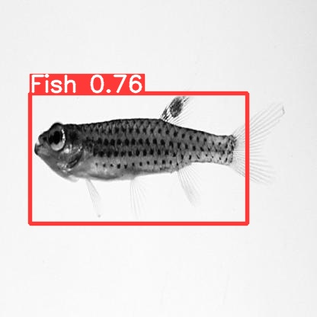
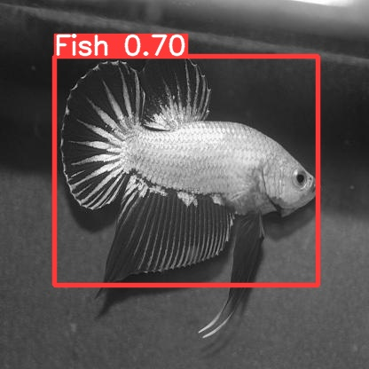
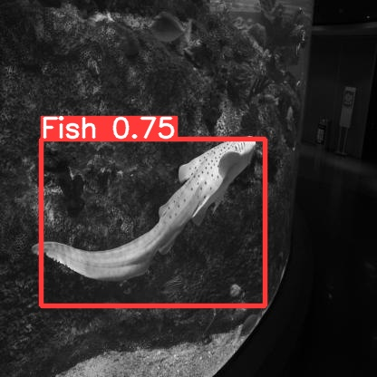
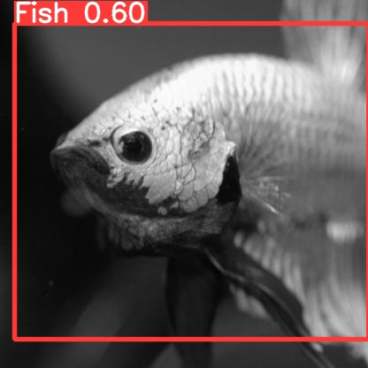
Fish Detection Algorithm

Slide 21
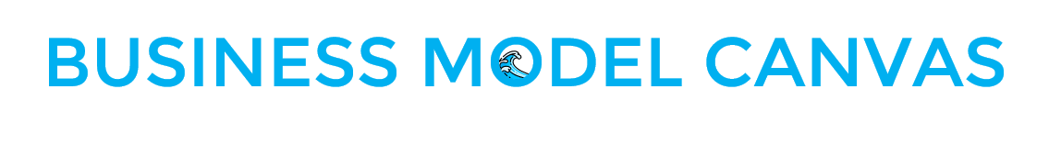
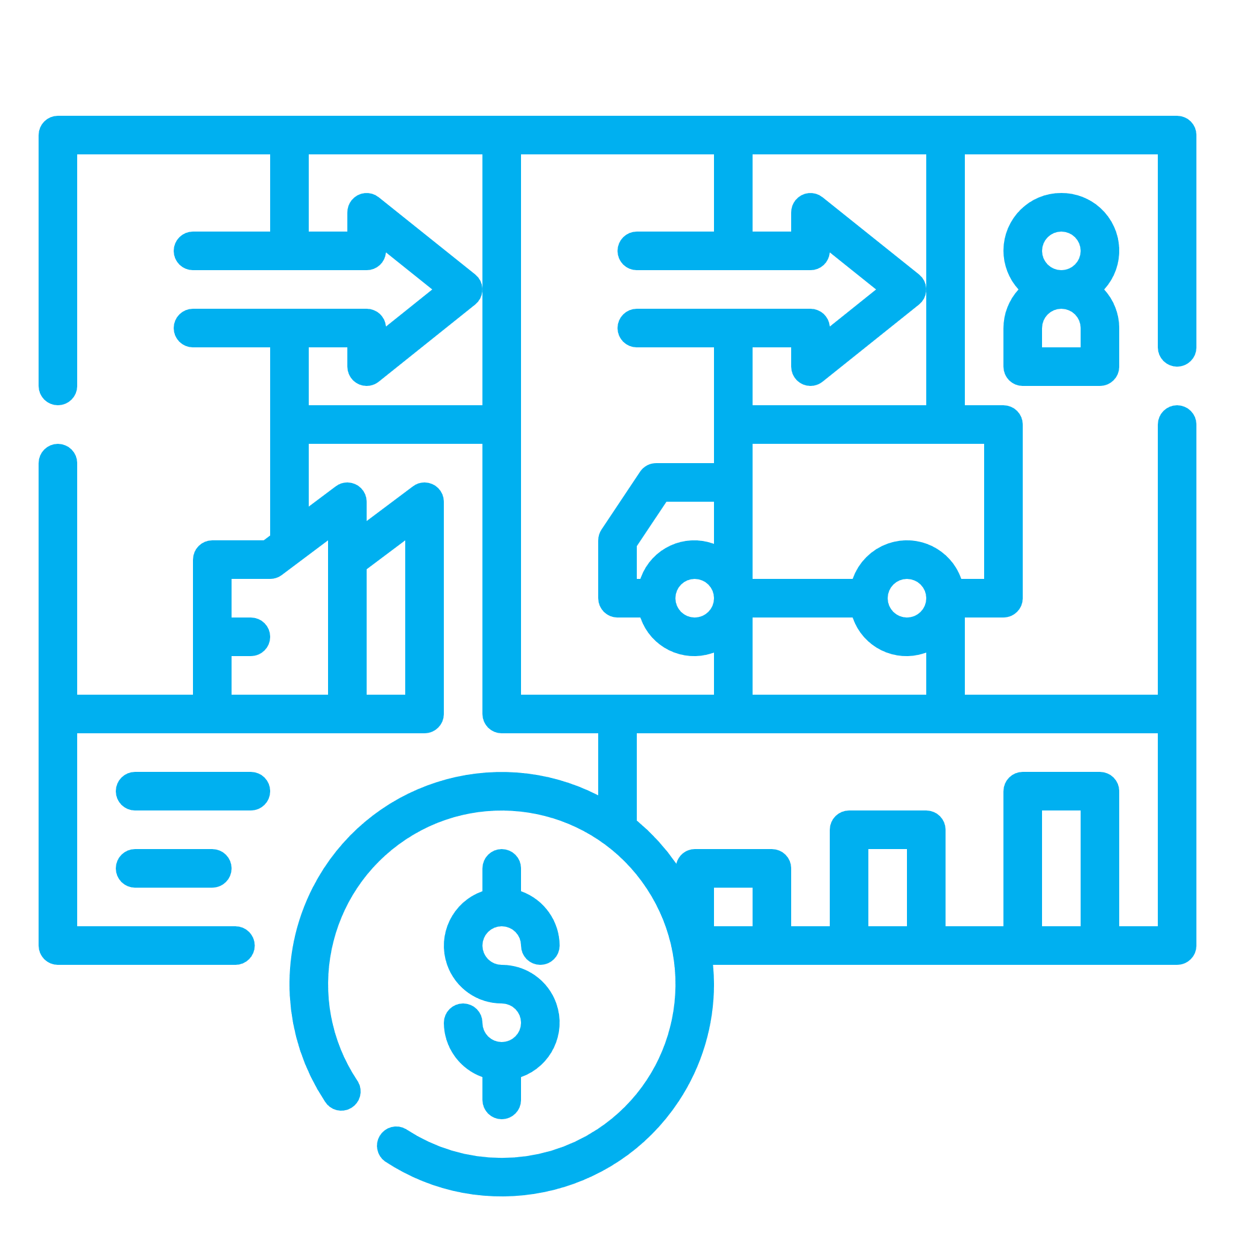

Slide 22









KEY PARTNERS
KEY ACTIVITIES
VALUE PROPOSITION
CUSTOMER RELATIONSHIPS
CUSTOMER SEGMENTS
Fish farmer clients
Research and Solution Development
Facilitates management data based on real-time data
Get: Reach out
Advertisements
Fish Farmers
GMES
Client Training and Support
Keep: Client feedback
Product upgrade
Immediate response
Excellent co-operation
Ministry of Fisheries and Aquaculture Development
Reduced need and cost spent on staff
Marketing
Fisheries Commission
The fishes are better cared for with little stress
KEY RESOURCES
CHANNELS
Hardware Resources
Power consumption optimization
Partnership Programmes
Advertisements
Financial Resources
Smart and specific: personalized farming
COST STRUCTURE
REVENUE STREAMS
Development
Maintenance
Marketing
Operations
Monthly Subscriptions
Premium Products

Slide 23
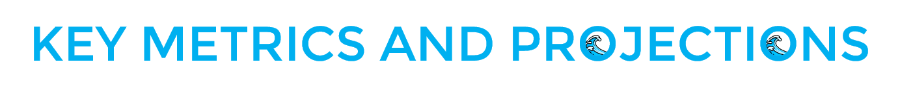
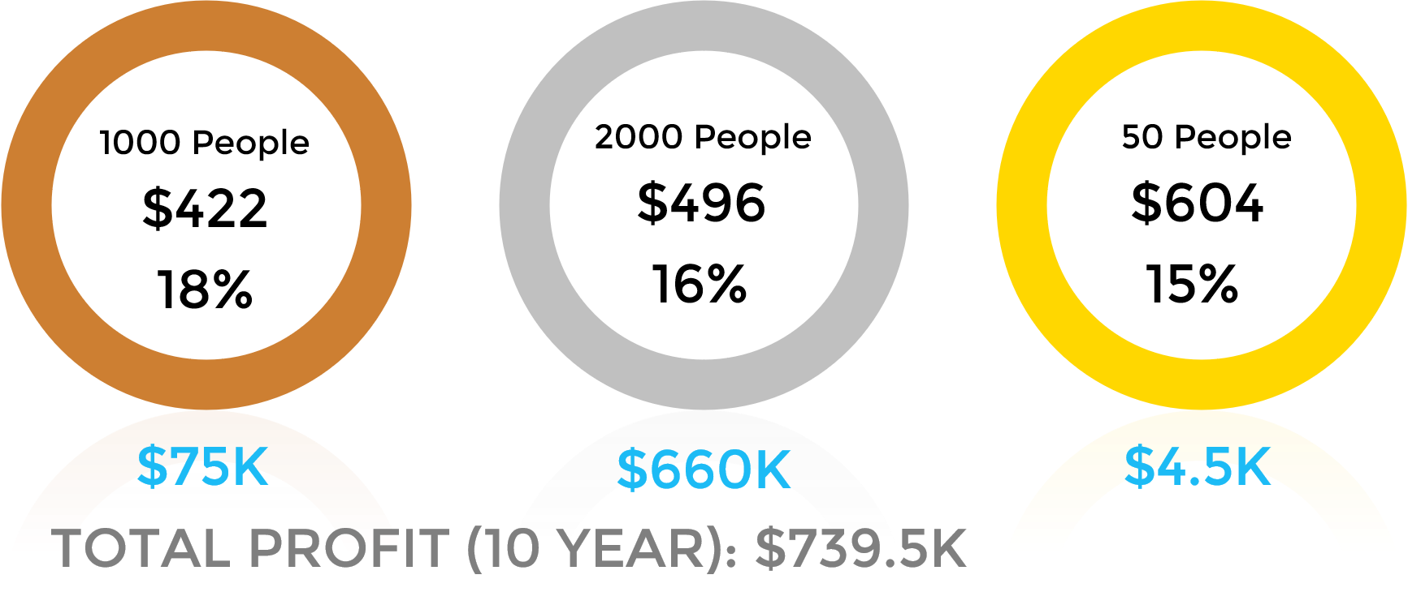


Slide 24
GHANA
WEST AFRICA
AFRICA
1 – 3 year period
3 – 5 year period
5 year + period

Slide 25


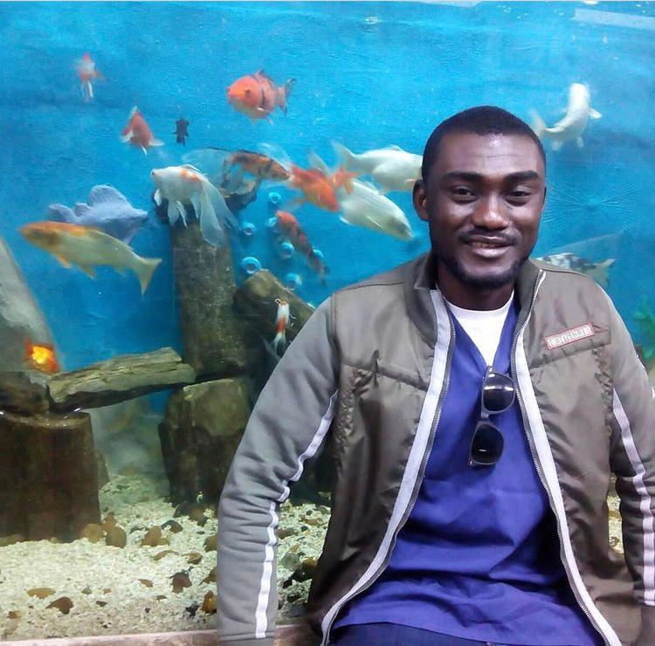
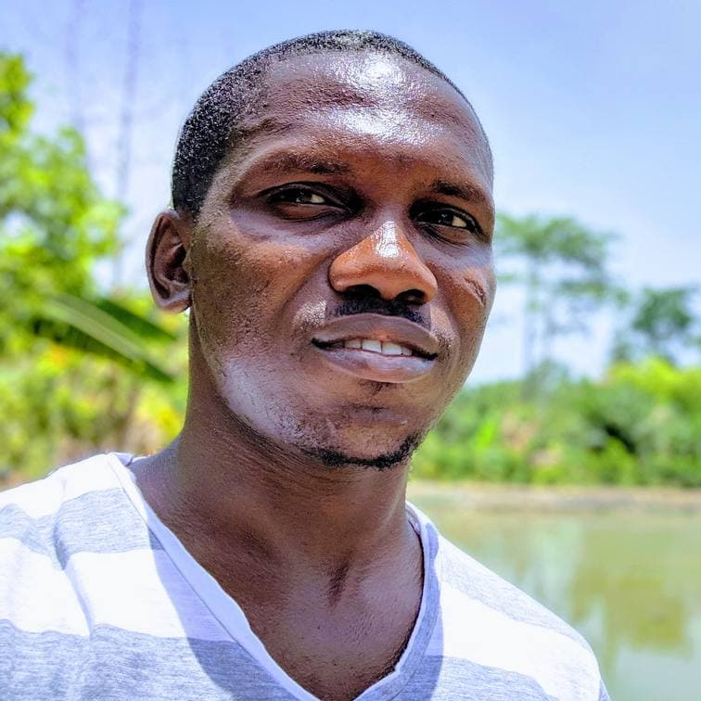
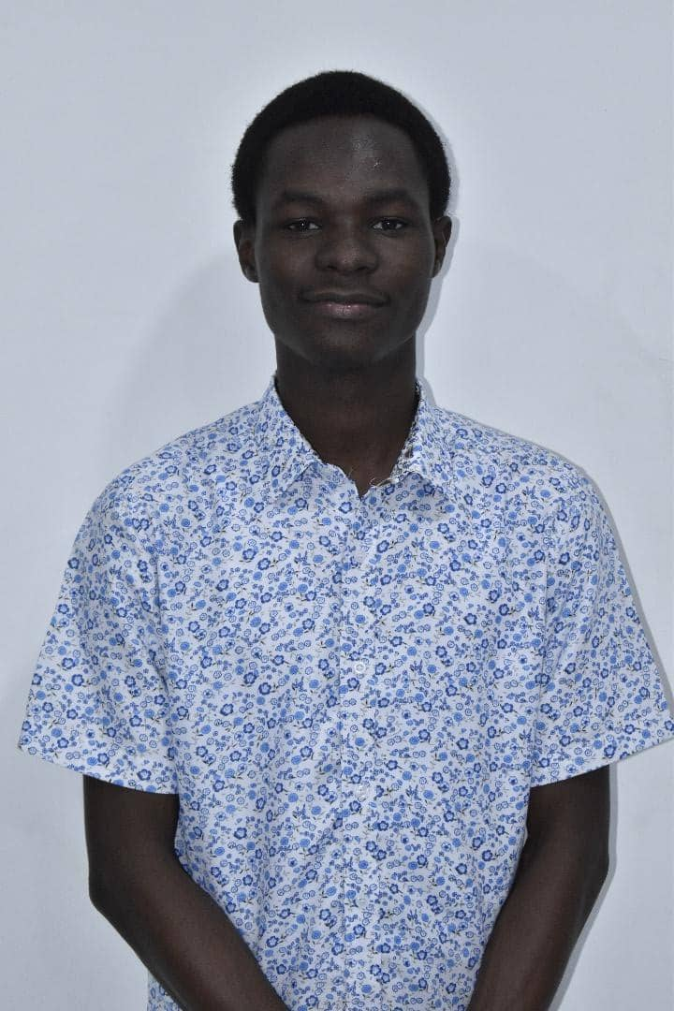
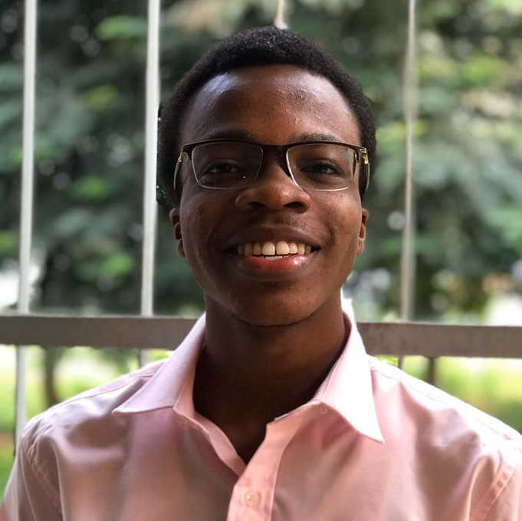

Selasi Avornyo
Kofi Anyan
Samuel Amponsah
Samuel Yawson
Mawunyo Avornyo

Slide 26


